Slide 1

Rutgers Data Science Bootcamp
Final Project: The Couch Vibes
Nov 11, 2021

Slide 2


The Couch Vibes
Kate Yayla
Saleha Ahmed
Meet Kamal Kaur
Brian Johnson
Jay Dhruv
Notes:
PATCH
Jay Dhruv
Meet K Kaur Sahni
Kate Yayla
Brian Johnson
Saleha Ahmed

Slide 3









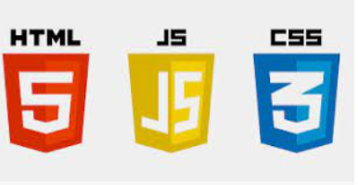


Technologies
Data Source
Shows and Episodes from TVTime.com with Mood Votes
https://www.kaggle.com/oscarfry/tvtime-shows
Notes:
We used the above technology throughout.

Slide 4
Show Success Model
Visualizations
Network Model
Project Overview
Notes:
PATCH

Slide 5
Machine Learning Models
For the Show Creators
Show Success Predictor
Predicts the Show Success based on the moods of the show
Features: Moods of the show on the range of 1 – 100
Label: Number of Followers of the show
Regression Model
For Audience
Network Predictor
Suggests the Network to watch based on the mood of the user.
Features: Moods of the user in the range 1 – 100
Label: Network
Classification Model

Slide 6
Steps for Show Success Predictor Model
Data Cleaning
Removing extraneous columns
Null values
Duplicates
Merging datasets by grouping shows
Individual scatter plots for each feature
Regularization: Coefficient plots with Linear Regression, Lasso, Ridge & ElasticNet
Function to test the familiar Regressors
Scaling the data – StandScaler & MinMaxScaler
Model Selection & Prediction
MSE & R-squared score: Lesson Learnt
Exported the model -> Flask implementation

Slide 7
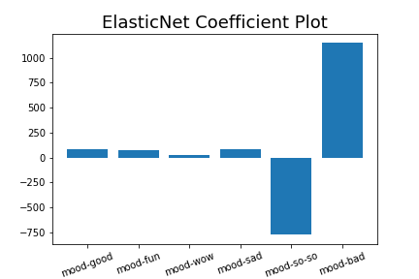
Show Success Predictor Model
Regularization: Coefficient plots with Linear Regression, Lasso, Ridge & ElasticNet

Slide 8
Steps for Show Success Predictor Model
Data Cleaning
Removing extraneous columns
Null values
Duplicates
Merging datasets by grouping shows
Individual scatter plots for each feature
Regularization: Coefficient plots with Linear Regression, Lasso, Ridge & ElasticNet
Function to test the familiar Regressors
Scaling the data – StandScaler & MinMaxScaler
Model Selection & Prediction
MSE & R-squared score: Lesson Learnt
Exported the model -> Flask implementation

Slide 9
Show Success Predictor Model
Label | Models | Training Score | Testing Score | Inference
Show Success/ Number of Followers Features: Moods of the show | Linear Regression | 0.77 | 0.77 | Fair scores
 | KNeighborsRegressor | 0.81 | 0.80 | Good scores
 | RandomForestRegressor | 0.95 | 0.85 | BEST testing score; Less gap between training & testing score
 | ExtraTreesRegressor | 0.99 | 0.84 | Good testing & training scores; Gap between training & testing scores
 | AdaBoostRegressor | 0.92 | 0.75 | Gap between training & testing scores
 | SVR | -0.01 | - 0.01 | Not accurate scores

Slide 10

Model Comparison for Show Success Predictor
Regressor

Slide 11
Steps for Show Success Predictor Model
Data Cleaning
Removing extraneous columns
Null values
Duplicates
Merging datasets by grouping shows
Individual scatter plots for each feature
Regularization: Coefficient plots with Linear Regression, Lasso, Ridge & ElasticNet
Function to test the familiar Regressors
Scaling the data – StandScaler & MinMaxScaler
Model Selection & Prediction
MSE & R-squared score: Lesson Learnt
Exported the model -> Flask implementation

Slide 12
Show Success Predictor Model – Flask Implementation

Slide 13
Machine Learning Models
For the Show Creators
Show Success Predictor
Predicts the Show Success based on the moods of the show
Features: Moods of the show on the range of 1 – 100
Label: Number of Followers of the show
Regression Model
For Audience
Network Predictor
Suggests the Network to watch based on the mood of the user.
Features: Moods of the user in the range 1 – 100
Label: Network
Classification Model

Slide 14
Steps for Network Predictor Model
Data Cleaning
Removing extra columns, Null values, Duplicates
Filtered based on specific runtime (15-90 mins), Top 10 US Networks, Number of episodes > 3
Removed special entries like sports events, live events, awards, etc.
Removed all entries where all mood reactions were 0
Removed data related to Netflix as it was skewing our entire data and model due to several entries
Merging datasets by grouping shows
Label Encoding of Labels (Networks) and MinMaxScaler scaling (between 1-100) of input data (Moods)
Splitting Training & Testing Data
Hyper tuning parameters, Model, Fit & Predict Classification models
Exported the model -> Flask implementation
Reverse Label Encoding in Flask to display Network Name

Slide 15
Network Predictor Model
Label | Models | Training Score | Testing Score | Inference
Network Name Features: Moods of the show | Logistic Regression | 0.23 | 0.21 | Only predicts one type of network and lacks variety
 | Random Forest Classifier | 0.99 | 0.22 | Overfitting training data as there is vast difference between the scores
 | Extra Trees Classifier | 0.99 | 0.22 | Overfitting training data as there is vast difference between the scores
 | Ad A Boost Classifier | 0.26 | 0.19 | Low scores but not overfitting the data
 | Random Forest Classifier (Hyper tuned model) | 0.22 | 0.21 | Less Training and Testing score but no overfitting
 | Extra Trees Classifier (Hyper tuned model) | 0.22 | 0.22 | Better Testing score than hyper tuned Random Forest and a better classification of the data
 | K Neighbors Classifier | 0.17 | 0.33 | Model is overfit as testing score is more than training score

Slide 16

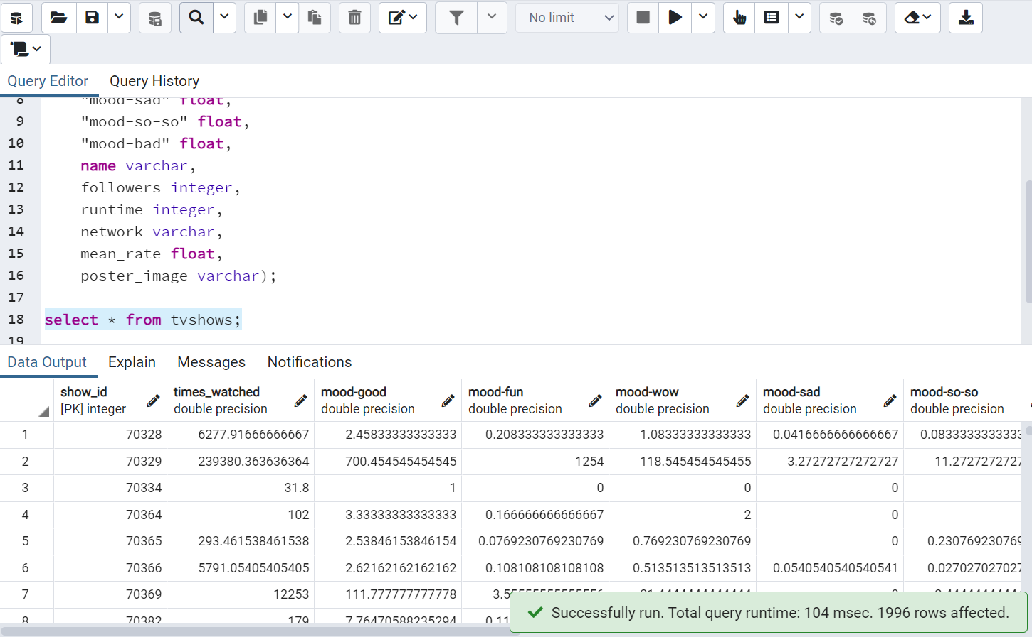
Creating DB in SQL, ETL & Flask
Notes:
- There was an option of a live api too but since that was updating continuously, that could break our code and also our dataset would be too large and make our web site slower (would also be not suitable for Heroku which we realized later).

Slide 17

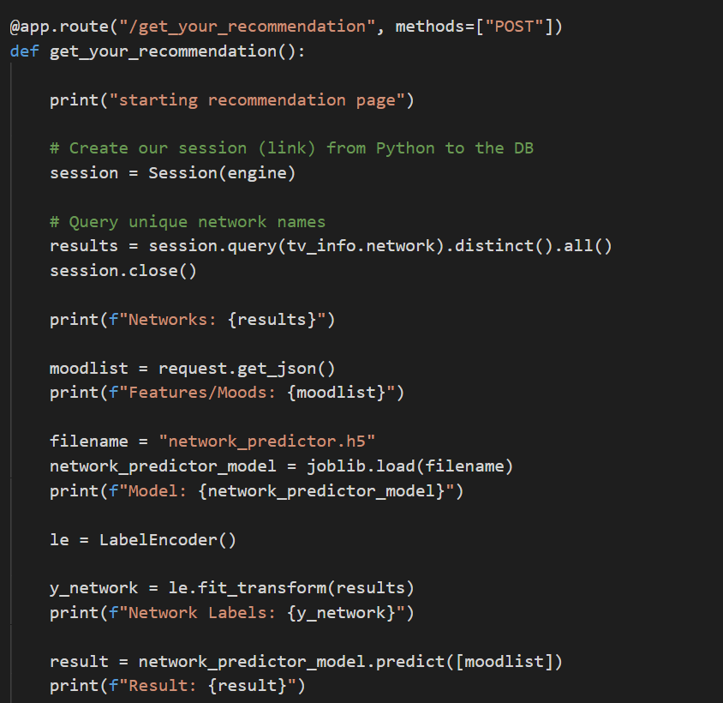
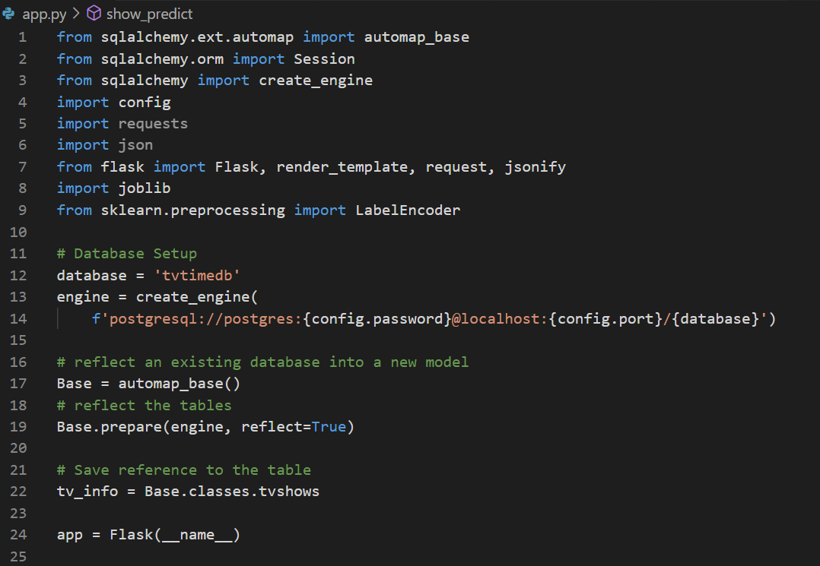
Data Cleaning, creating DB in SQL, ETL & Flask
Flask:
app.py was setup to include the routes for our tables and 5 html pages.
Used SQLAlchemy to connect to our database.
Notes:
- There was an option of a live api too but since that was updating continuously, that could break our code and also our dataset would be too large and make our web site slower (would also be not suitable for Heroku which we realized later).

Slide 18
Web Design
Created one Landing page and 4 other pages using Bootstrap and CSS as following:
Landing page: 4 links to other pages.
Network page: gives network suggestion based on model. Uses sliders and dropdown for parameters.
Followers page: which predicts whether a show will be successful or note based on model. Uses sliders for parameters.
Visualizations page: displays analysis using Tableau visualizations.
Team page: that has team information

Slide 19


Thank you!!
Please visit our GitHub page to see more details about our project:
GitHub Link: https://github.com/meetk5/Team-Project4
Notes:
PATCH
Jay Dhruv
Meet K Kaur Sahni
Kate Yayla
Brian Johnson
Saleha Ahmed

